Slide 1

Kafka In Microservices Architecture
Technical training
Ho Chi Minh 22 MAR 2021
Thach Le Van
Ahmad Maziz Bin Esa
Hai Nguyen Ngoc

Slide 2

AGENDA
What is Kafka?
Kafka Fundamentals
Topic, Partition, Partition Offset
Brokers
Replication
Cluster
Producers and consumers
Leader and Follower
Logs and ZooKeeper
Kafka - Scaling
Kafka - Event and Command concept
Recommendations
Kafka in Microservices system
Kafka - Serialization & Deserialization
Kafka installation and demonstration

Slide 3
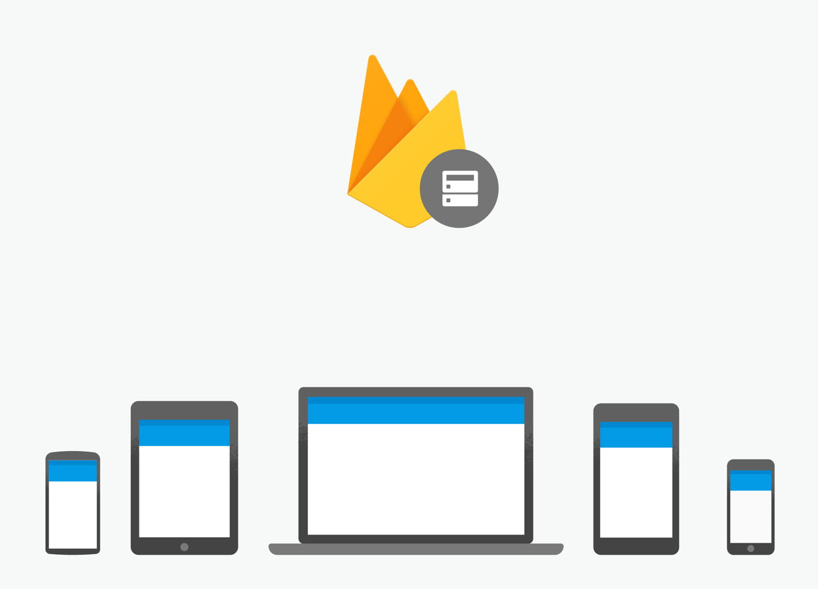
What is Kafka?
What is a Messaging System?
A Messaging System is responsible for transferring data from one application to another
A Distributed Messaging System is based on the concept of reliable message queuing. Messages are queued asynchronously between client applications and messaging system.
Two types of messaging patterns
point to point
publish-subscribe or pub-sub (Mostly used)

Slide 4
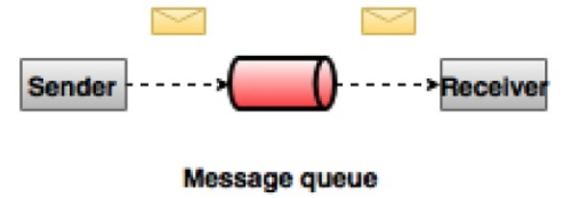
What is Kafka?
Point to Point Messaging System
In a point-to-point system, messages are persisted in a queue. One or more consumers can consume the messages in the queue, but a particular message can be consumed by a maximum of one consumer only. Once a consumer reads a message in the queue, it disappears from that queue.

Slide 5
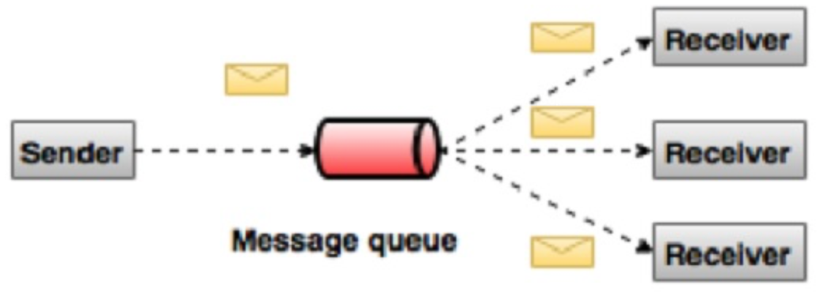
What is Kafka?
Publish-Subscribe Messaging System
In the publish-subscribe system, messages are persisted in a topic. Unlike point-to-point system, consumers can subscribe to one or more topic and consume all the messages in that topic. In the Publish-Subscribe system, message producers are called publishers and message consumers are called subscribers.

Slide 6
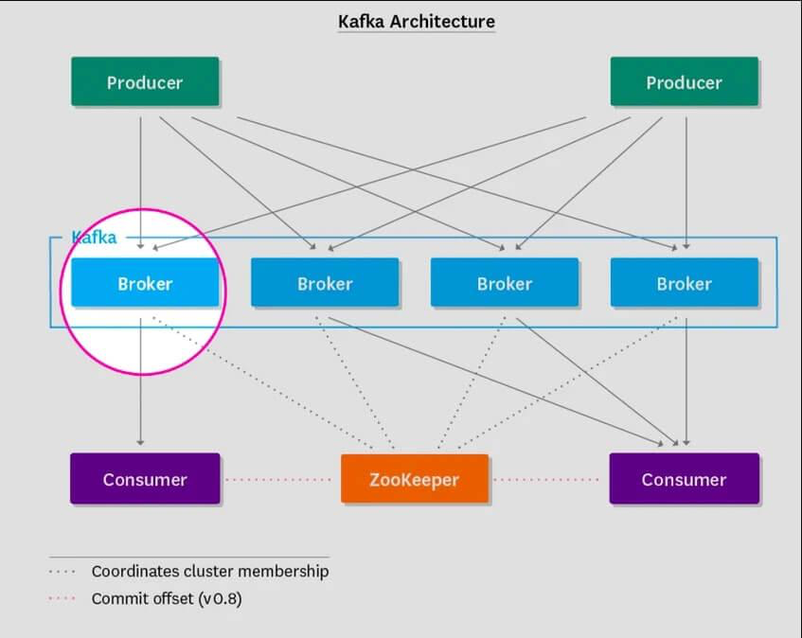
What is Kafka?
Apache Kafka is a distributed publish-subscribe messaging system and a robust queue that can handle a high volume of data and enables you to pass messages from one end-point to another. Kafka is suitable for both offline and online message consumption. Kafka messages are persisted on the disk and replicated within the cluster to prevent data loss. Kafka is built on top of the ZooKeeper synchronization service.
Reliability − Kafka is distributed, partitioned, replicated and fault tolerance.
Scalability − Kafka messaging system scales easily without down time..
Durability − Kafka uses Distributed commit log which means messages persists on disk as fast as possible
Performance − Kafka has high throughput for both publishing and subscribing messages. It maintains stable performance even many TB of messages are stored

Slide 7
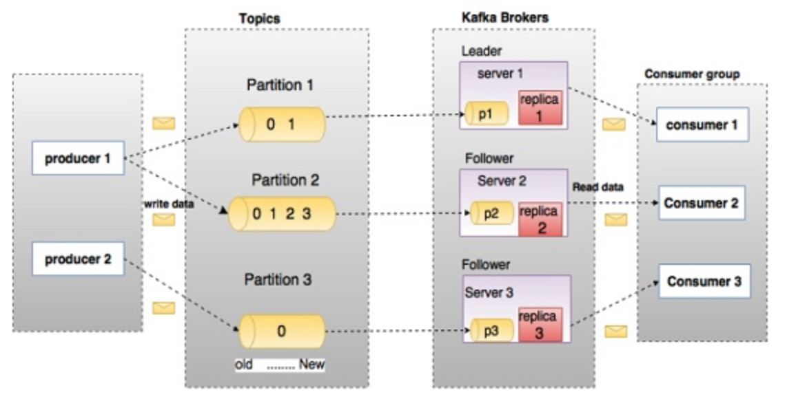
Kafka Fundamentals

Slide 8
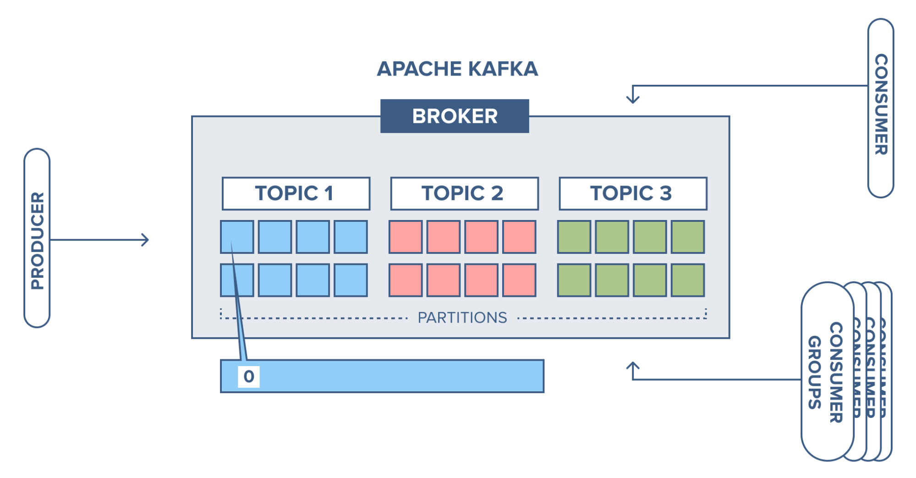
Kafka Fundamentals
Topics: A stream of messages belonging to a particular category is called a topic. Data is stored in topics. Topics are split into partitions. For each topic, Kafka keeps a minimum of one partition. Each such partition contains messages in an immutable ordered sequence. A partition is implemented as a set of segment files of equal sizes

Slide 9
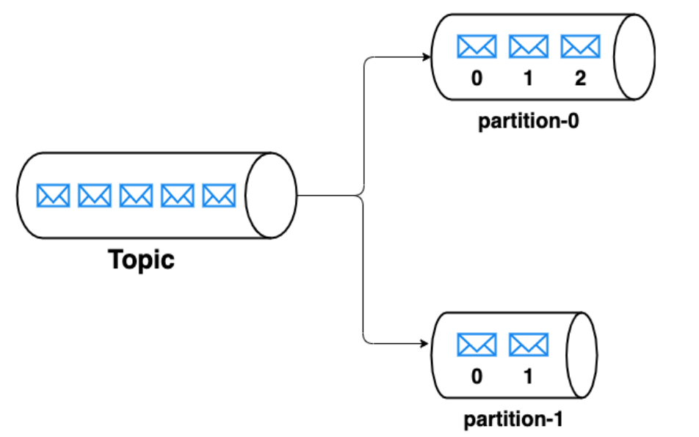
Kafka Fundamentals
In kafka, a partition is an ordered immutable collection of messages. Each topic is divided into multiple partitions. Each message in a partition is assigned a unique sequential id named offset.
Partition: Topics may have many partitions, so it can handle an arbitrary amount of data.
Partition offset: Each partitioned message has a unique sequence id called as offset.

Slide 10
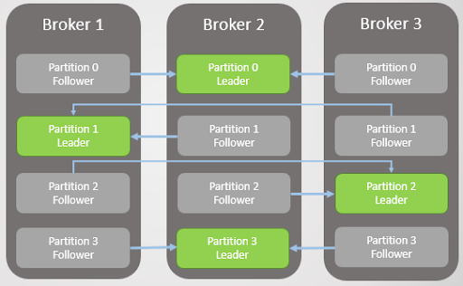
Kafka Fundamentals
Brokers
Brokers are simple system responsible for maintaining the published data. Each broker may have zero or more partitions per topic. Assume, if there are N partitions in a topic and N number of brokers, each broker will have one partition.

Slide 11
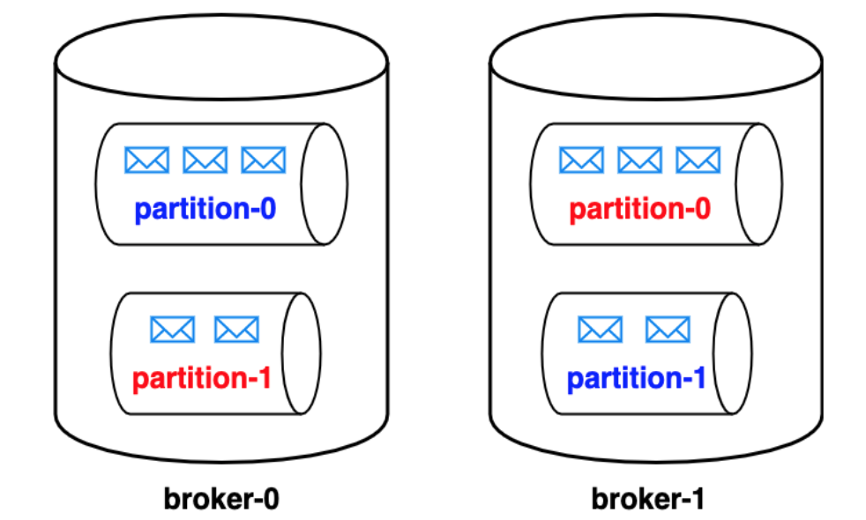
Kafka Fundamentals
Replicas of partition
Kafka supports replication of partitions across brokers. The number of partitions (p) per topic & the number of replicas (n) per partition can be configured. So, the total number of replicas per topic would be p x n. For every partition, one broker acts as a leader, and the other brokers act as its followers. Whenever the message is written to a partition, the leader persists this message to the partition’s replica(s) contained within the leader. The leader also makes sure that each one of the other brokers copy this message to the partition’s replica contained within them. In this way, kafka ensures that every message written to a partition is copied to all the replicas of that partition. Whenever a leader of a partition is disconnected, one of its followers is selected as a leader.
Notes:
Partitions and replication enable the data of a single topic to be distributed across brokers thus achieving distributed storage & fault tolerance. For instance, let us say our kafka cluster has two brokers broker-0 & broker-1. Our topic has two partitions partition-0 & partition-1 with two replicas each. partition-0, partition-0 represent the replicas of partition-0 for which broker-0 acts as a leader. Similarily, partition-1, partition-1 represent the replicas of partition-1 for which broker-1 acts as a leader. Let us say one of our brokers broker-0(leader of partition-0) goes down due to power outage. We can still have our cluster up and running as we have a replica of partition-0 i.e partition-0 in broker-1. Now, broker-1is promoted as the leader for the partition-0 thereby achieving fault tolerance.

Slide 12
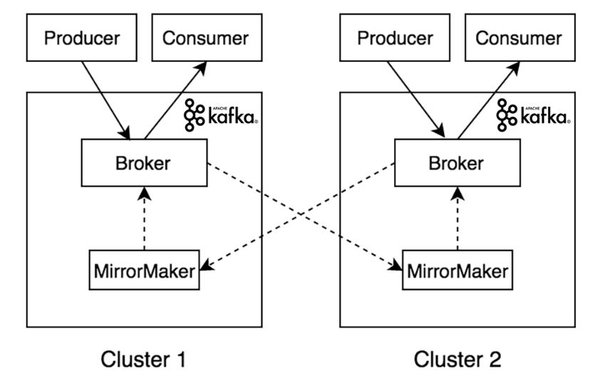
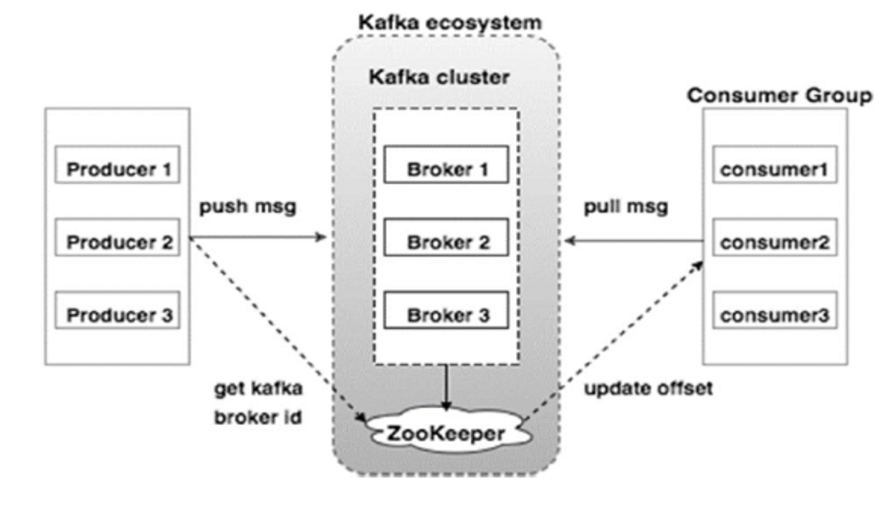
Kafka Fundamentals
Kafka Cluster
Kafka’s having more than one broker are called as Kafka cluster. A Kafka cluster can be expanded without downtime. These clusters are used to manage the persistence and replication of message data.
Notes:
Broker: Kafka cluster typically consists of multiple brokers to maintain load balance. Kafka brokers are stateless, so they use ZooKeeper for maintaining their cluster state. One Kafka broker instance can handle hundreds of thousands of reads and writes per second and each broker can handle TB of messages without performance impact. Kafka broker leader election can be done by ZooKeeper.
ZooKeeper: ZooKeeper is used for managing and coordinating Kafka broker. ZooKeeper service is mainly used to notify producer and consumer about the presence of any new broker in the Kafka system or failure of the broker in the Kafka system. As per the notification received by the Zookeeper regarding presence or failure of the broker then producer and consumer takes decision and starts coordinating their task with some other broker.
Producers: Producers push data to brokers. When the new broker is started, all the producers search it and automatically sends a message to that new broker. Kafka producer doesn’t wait for acknowledgements from the broker and sends messages as fast as the broker can handle.
Consumers: Since Kafka brokers are stateless, which means that the consumer has to maintain how many messages have been consumed by using partition offset. If the consumer acknowledges a particular message offset, it implies that the consumer has consumed all prior messages. The consumer issues an asynchronous pull request to the broker to have a buffer of bytes ready to consume. The consumers can rewind or skip to any point in a partition simply by supplying an offset value. Consumer offset value is notified by ZooKeeper.

Slide 13
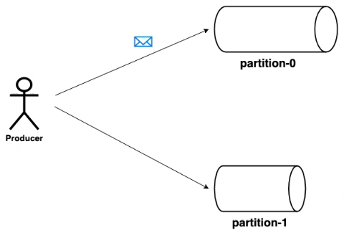
Kafka Fundamentals
Producers
Producers are the publisher of messages to one or more Kafka topics. Producers send data to Kafka brokers. Every time a producer publishes a message to a broker, the broker simply appends the message to the last segment file. Actually, the message will be appended to a partition. Producer can also send messages to a partition of their choice.

Slide 14
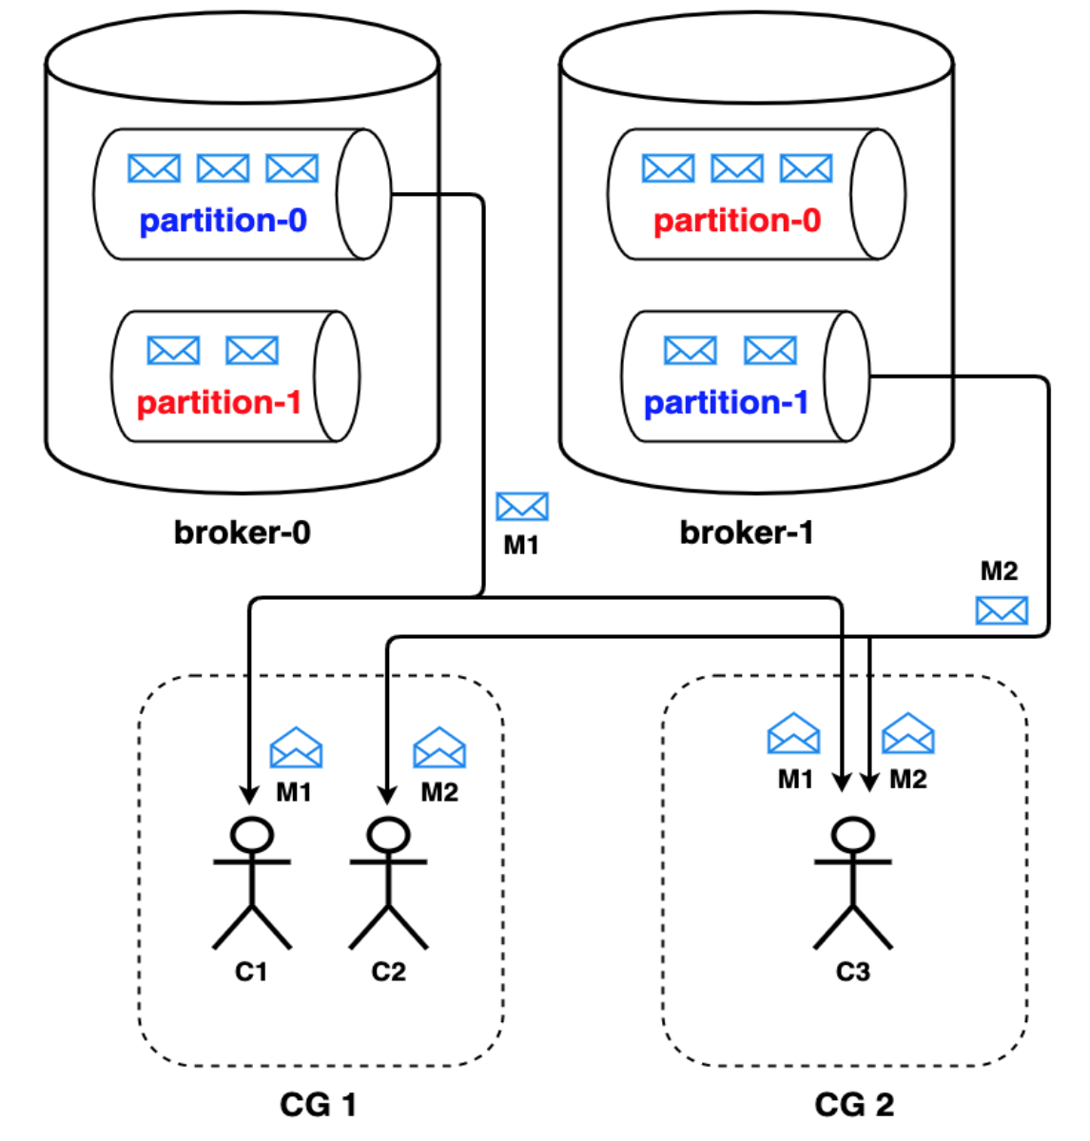
Kafka Fundamentals
Consumers
In Kafka, consumers are grouped into consumer groups. A consumer group when subscribed to a topic, ensures that it reads all the messages of that topic. Consumer reads from the partition’s replica that lives in the leader of that partition. For each partition, the consumer maintains an offset that indicates the offset of last processed message in the partition. This offset helps in ensuring that a message is not processed multiple times. Thus, messages within a topic are consumed parallely by multiple consumers leading to high throughput.
Notes:
Let’s say we have two consumer groups CG1 and CG2 with two & one consumers respectively. They are subscribed to a topic with two partitions. In case of CG1, the partitions are evenly distributed across consumers C1 and C2, each getting one partition to read from. On the other hand, since CG2 has only one consumer C3, it has to process messages from both the partitions.
Let’s say one of the consumer C1 of a consumer group CG1 goes down. In this case, the consumer group redistributes the partitions among the remaining consumers i.e C2. Therefore, the functional consumer C2 starts reading from both the partitions of the topic. Thus Kafka ensures that each consumer group as a whole, processes all the messages of the subscribed topic. This in a way, also depicts the fault tolerant behaviour of kafka.

Slide 15
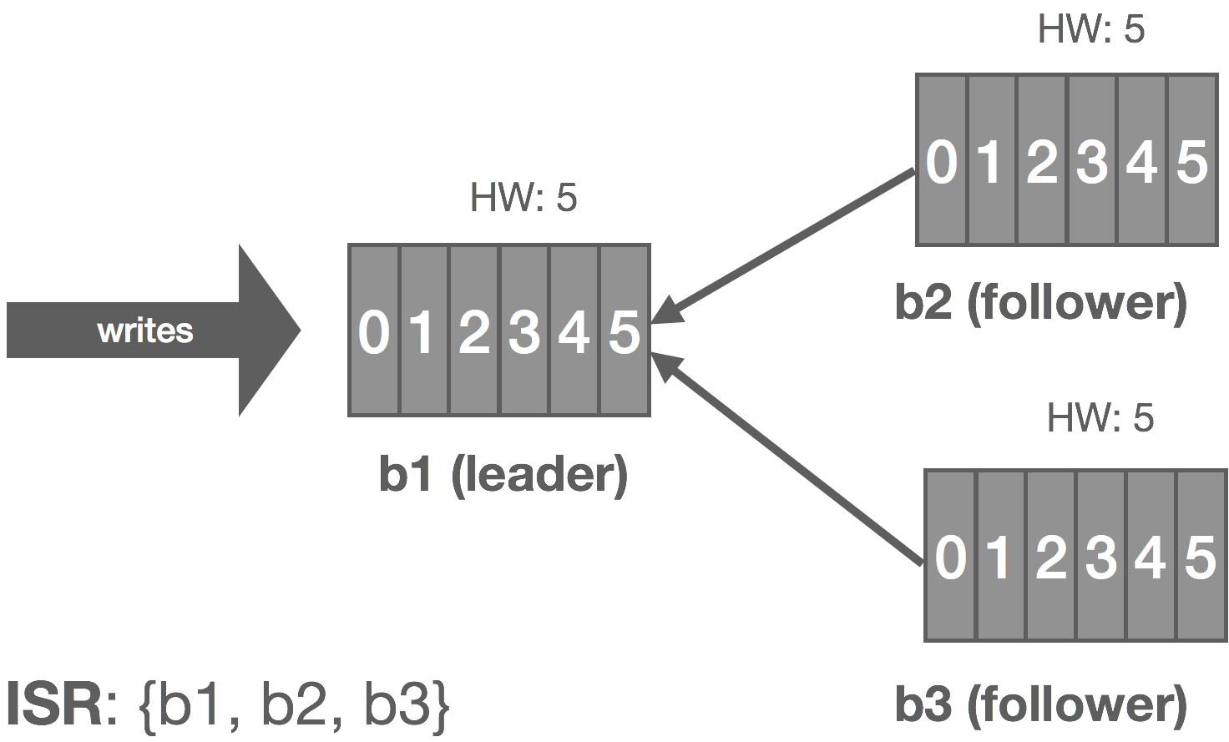
Kafka Fundamentals
Leader
Leader is the node responsible for all reads and writes for the given partition. Every partition has one server acting as a leader.
Follower
Node which follows leader instructions are called as follower. If the leader fails, one of the follower will automatically become the new leader. A follower acts as normal consumer, pulls messages and updates its own data store.

Slide 16
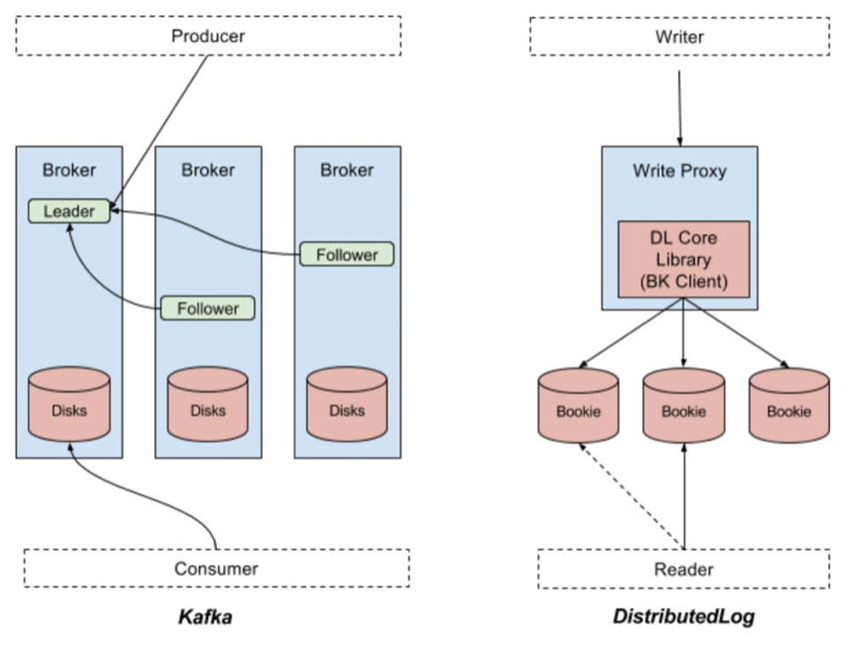
Kafka Fundamentals
Apache Kafka logs is a consistently ordered data structure that only supports append. You cannot edit or delete records. It’s read from left to right and has guaranteed order of items. A data source will write the message to the log and one or more other consumers will read the message from the log at the time they choose

Slide 17
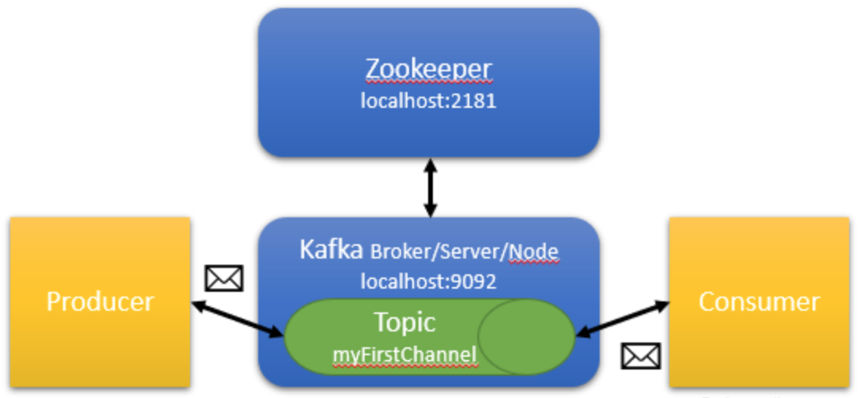
Kafka Fundamentals
Zookeeper is store distributed data in the form of key-value. It is optimized for fast read but slow write. Kafka uses Zookeeper to perform the promote leader of partition. Zookeeper is also designed for high fault tolerance, so Kafka depends heavily on Zookeeper.
Using for stored metadata:
Quota of consumer/producer (maximum amount of data per second)
Offset each of partition of consumer group
ACL(Access Control List)
Partition Leader and status

Slide 18
Scaling
Partition: Splits a topic into multiple partitions and increasing partitions is a mechanism of scaling.
Distribution: Cluster can have one or more brokers and these brokers can be increased to achieve scaling.
Replication: Similar to partitions, multiple replication of a message is there for fault-tolerance and this aspect also brings in scalability in Kafka.
Scaling: Each consumer reads a message from a single partition (of a topic) and to scale out we add more consumers and the newly added consumers read the message from new partition (one consumer cannot read from the same partition; this is a rule).

Slide 19
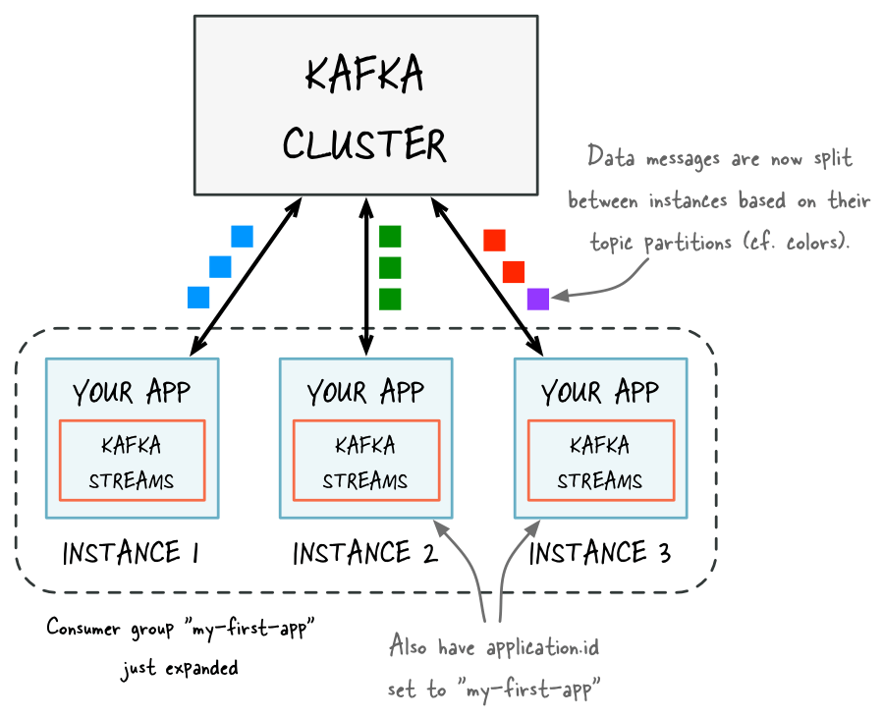
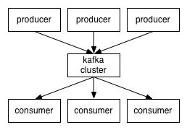
Scaling

Slide 20
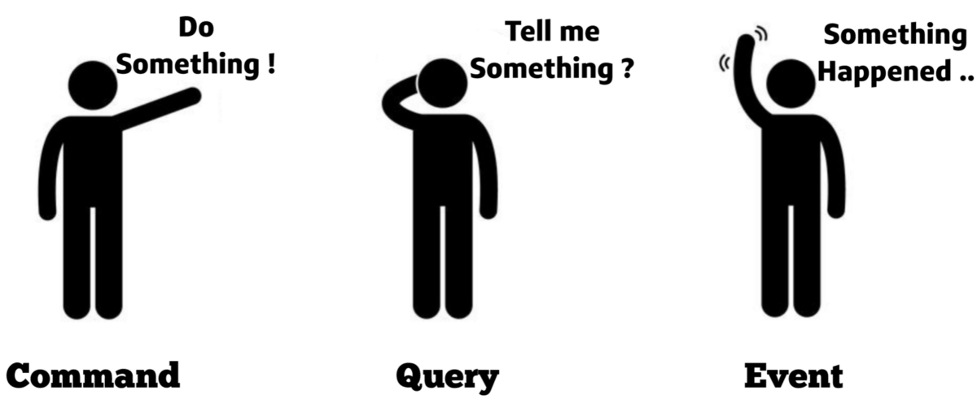
Events and Commands

Slide 21
Events and Commands
Command
Describes a request that is to be executed.
A command requires some action to be performed by a processor, and this action should be performed only once by this processor.
Event
Describes something that has happened
An event is the notification of some action that was already executed or an external happening. Several processors/agents may be interested in knowing about the event. Several of them may further issue commands or action required by this notification in their domain of responsibility

Slide 22
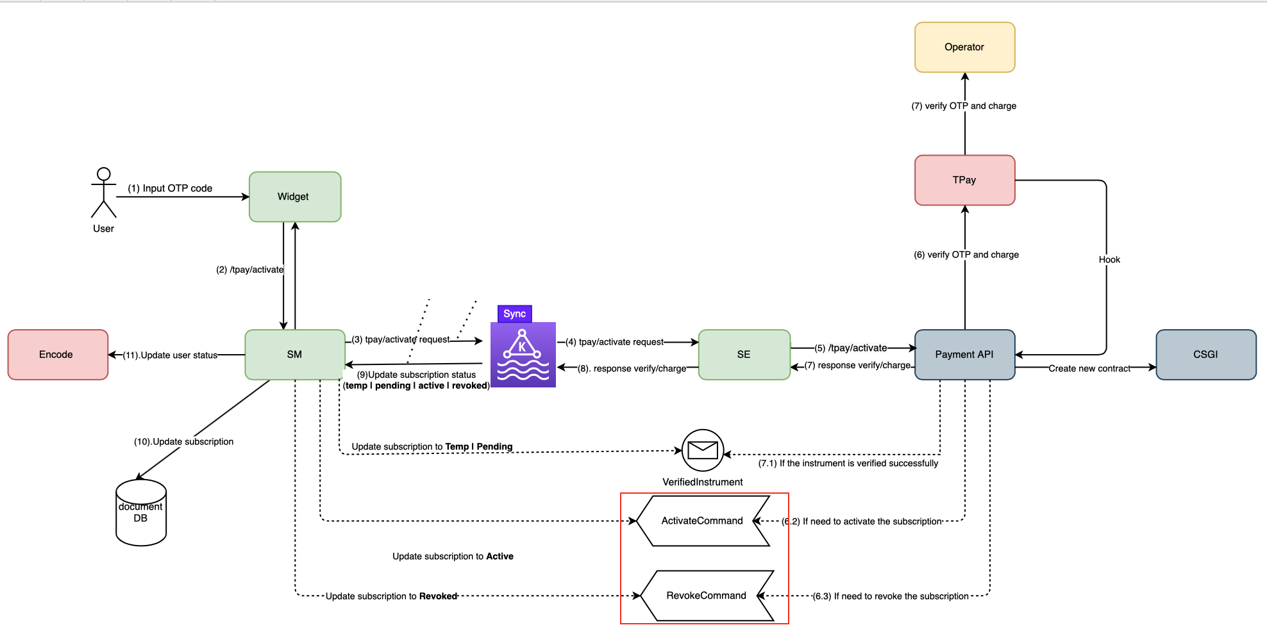
Events and Commands

Slide 23

Recommendations
Best Apache Kafka Use Cases
Real-time data processing: Many modern systems require data to be processed as soon as it becomes available. Kafka can be useful here since it is able to transmit data from producers to data handlers and then to data storages.
Application activity tracking: Each event that occurs in the application can be published to the dedicated Kafka topic. User clicks, registrations, likes, time spent on certain pages by users, orders, etc. – all these events can be sent to Kafka’s topics. Then, other applications (consumers) can subscribe to topics and process the received data for different purposes including monitoring, analysis, reports, newsfeeds, personalization, and so on.
Logging and/or monitoring system: Apache Kafka can be used for logging or monitoring. It is possible to publish logs into Kafka topics. The logs can be stored in a Kafka cluster for some time

Slide 24

Recommendations
When Not To Use Kafka
Kafka is an overkill when you need to process only a small amount of messages per day (up to several thousand). Kafka is designed to cope with the high load.
Kafka is a great solution for delivering messages. But despite the fact that Kafka has a Stream API, it is not easy to perform data transformations on-fly. You need to build a complex pipeline of interactions between producers and consumers and then maintain the entire system. This requires a lot of work and efforts. So, avoid using Kafka for ETL jobs, especially where real-time processing is needed.
When you need to use a simple task queue you should use appropriate instruments. Kafka is not designed to be a task queue.
If you need a database, use a database, not Kafka. Kafka is not good for long-term storage. It supports saving data during a specified retention period, but generally, it should not be very long.

Slide 25
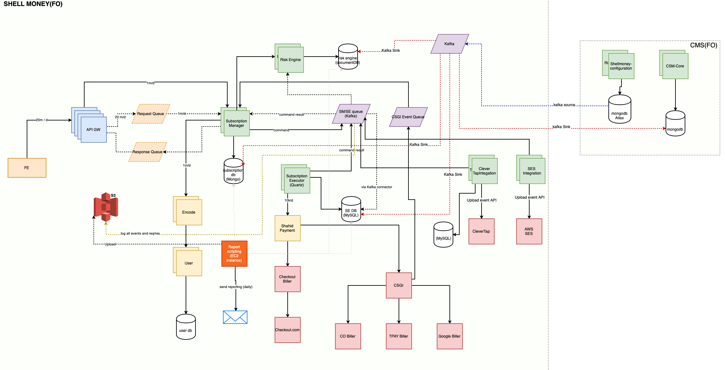
Kafka in Microservices system

Slide 26
Kafka - Serialization & Deserialization

Slide 27
Kafka - SerDes with Avro Why oh why..
Leverage previous experience using Avro (team and client)
It’s mandatory to specify the Serdes in kafka producer / config (String*serializer)
Maintainability (changing schema, data type and compatibility; as long as follow best practices)
Efficiency (small size and fast)
Make explicit (also declarative) the data send / receive (default values, type)
Enable versioning of your messages (events) (backward? Forward? compatibility)
Reduce coupling between micro-services via messaging system
As an API between producer and consumer
Notes:
No Schema, fail due to null or add / remove data
May fail silently add / remove field
Performance not main thing as we didn’t do stringent performance comparison

Slide 28
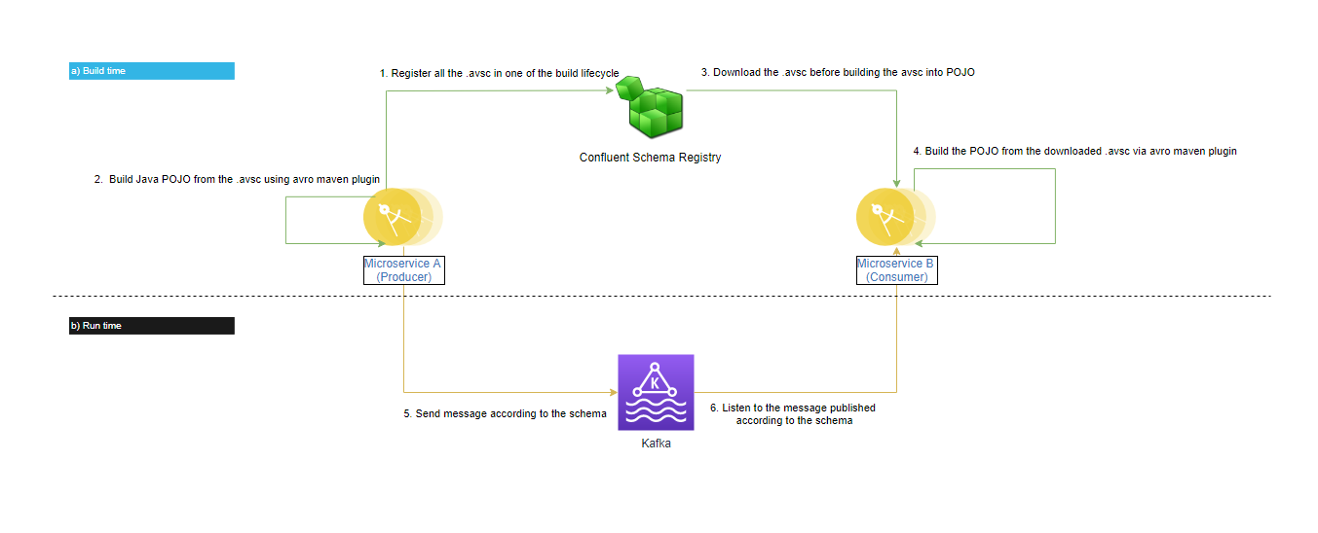
Kafka - SerDes Distributed Avro System
Credit, https://maziz88.medium.com/distributed-kafka-avro-schema-system-via-registry-35baf5b6dde1
2 Approaches. Shell Money uses this. Older project uses the other (via maven repository as artifact)
Slight overhead on Devops (a docker image running on ECS). AWS Glue or using Confluent stack could alleviate this.
Step 1, 2, 3, 4, maven schema registry plugin will resolve the schema within the lifecycle
Step 6 handled by the kafka consumer, caching of the latest schema, so that it doesn’t call registry all the time
Schema Registry + maven plugin help distribute schema and build the POJO.

Slide 29
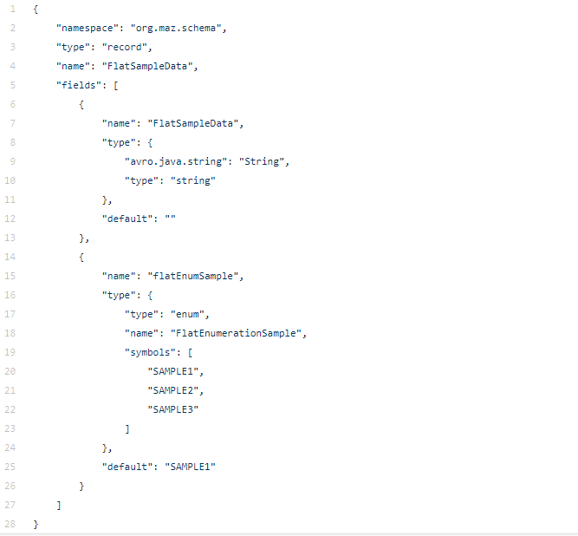
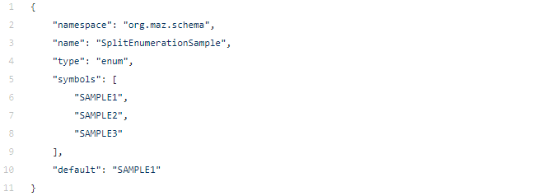
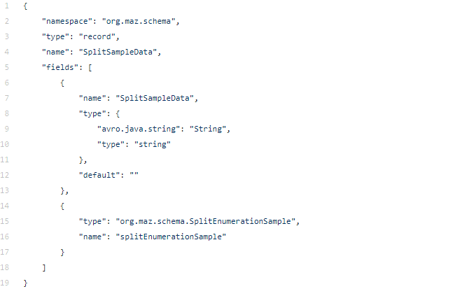
Kafka - Avro Schema (Flat vs Split)
Notes:
We attempted split but can’t due to dependency of version

Slide 30
Kafka - Avro Schema (Flat vs Split)
For split schema we need the following:
Schema Registry 5.5.1
Kafka Avro Serializer 5.5.1
Avro Version 1.9.2 at least
Avro Maven plugin 1.9.2 at least
Keep above in mind as kafka related tool requires inter-service compatibility. Our Flink support older version of the above so we can’t use Split schema (which we learned the hard way :P). Join our next knowledge sharing session on Flink to learn more.
Notes:
We attempted split but can’t due to dependency of version

Slide 31
Kafka installation and demonstration
Install Kafka using docker
Using Kafka CLI to Publish-Subscribe
Kafka consumer group
Spring cloud kafka stream binder

Slide 32
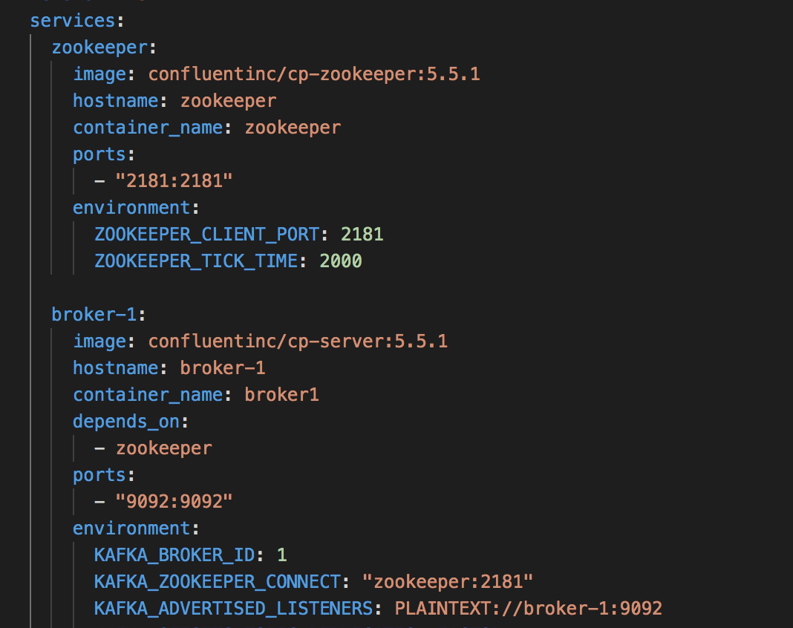
Kafka installation and demonstration
Install Kafka single node using docker

Slide 33
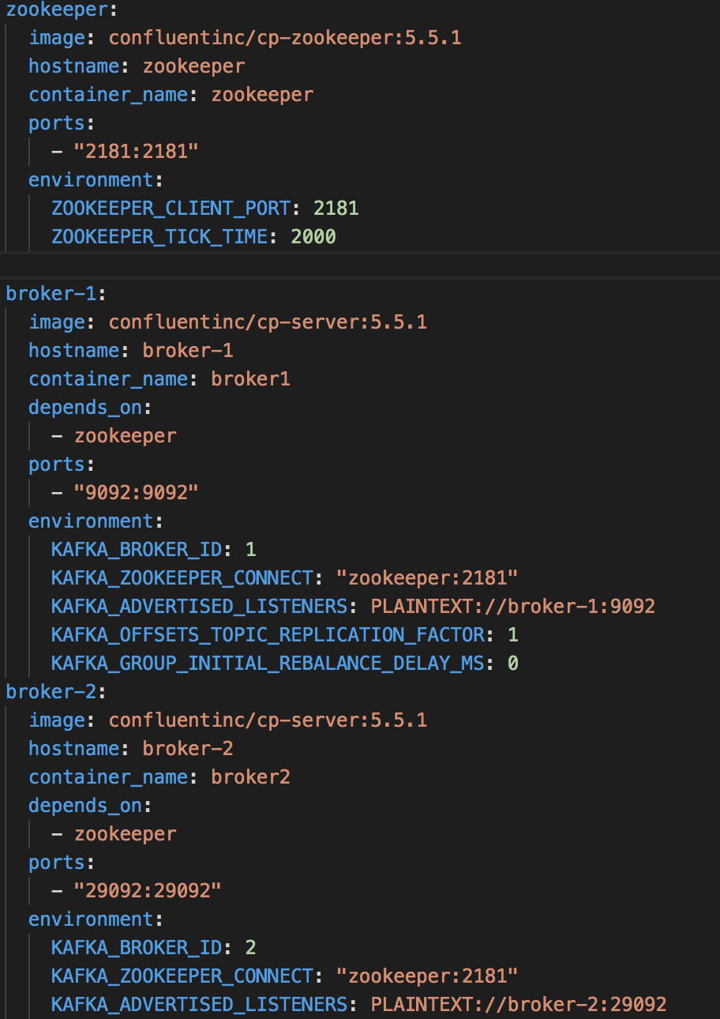
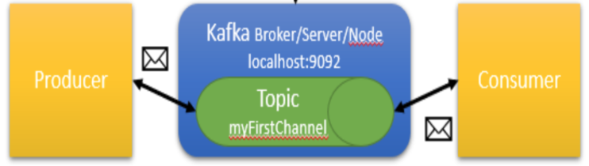
Kafka installation and demonstration
Install Kafka multiple nodes using docker
Kafka broker/Note 2 localhost:29092

Slide 34
Kafka installation and demonstration
Using Kafka CLI to Publish-Subscribe
Download kafka & cli tool https://mirror.downloadvn.com/apache/kafka/2.7.0/kafka_2.13-2.7.0.tgz
Create a kafka topic
./kafka-topics.sh --create --zookeeper localhost:2181 --replication-factor 1 --partitions 3 --topic my-topic
Describe the topic
./kafka-topics.sh --describe --zookeeper localhost:2181 --topic my-topic
Write some events into the topic
./kafka-console-producer.sh --broker-list localhost:9092 --topic my-topic

Slide 35
Kafka installation and demonstration
Using Kafka CLI to Publish-Subscribe
6. Read the events from the topic
./kafka-console-consumer.sh --bootstrap-server localhost:9092 --group test --topic my-topic --from-beginning
Kafka consumer group
./kafka-consumer-groups.sh --bootstrap-server localhost:9092 --list
./kafka-consumer-groups.sh --bootctrap-server localhost:9092 --group test --describe

Slide 36
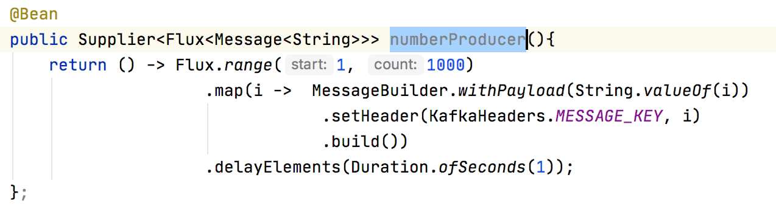
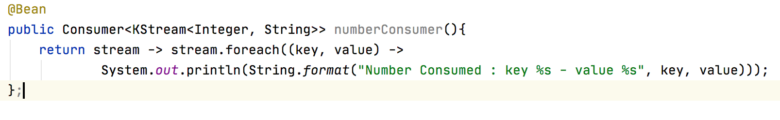
Kafka installation and demonstration
Spring cloud kafka stream binder
Producer
Consumer

Slide 37
Takeaways
We described Apache Kafka and the most suitable use cases for deploying this tool. It is easy to see why it is such a powerful streaming platform. Kafka is a valuable tool in scenarios requiring real-time data processing and application activity tracking, as well as for monitoring purposes. In the same time, Kafka shouldn’t be used for data transformations on-fly, data storing, and when all that you need is just a simple task queue.
Always populate default value of the field in schema (preferably that meet business requirements)
Try to leverage managed service to offset maintenance effort (AWS Glue or Confluent Stack)
Identify the component in your architecture versioning requirement (latest supported version. Usually managed services).

